Slide 1
Collaborative Platform 5
Team Members
Product Owners
Jorge Travieso
Adrian Alfonso
Juan Caraballo
Robert Loredo
Spring 2015

Slide 2
Problem Solution
Need for
Better interaction among users of the system.
Fast way to set up meetings.
The Collaborative Tools
Video Conference
Screen Sharing
Virtual Whiteboard
Chat Room
Simple Scheduling

Slide 3
Sprint # 5 Planning
User Story | Status | Points
Defect - Join Video Conference | Done | 16
Improve The Meeting Listing | Done | 4
Change Meeting Invitation Email Format | Done | 4
Cancel Video Conference Meeting | Done | 8

Slide 4
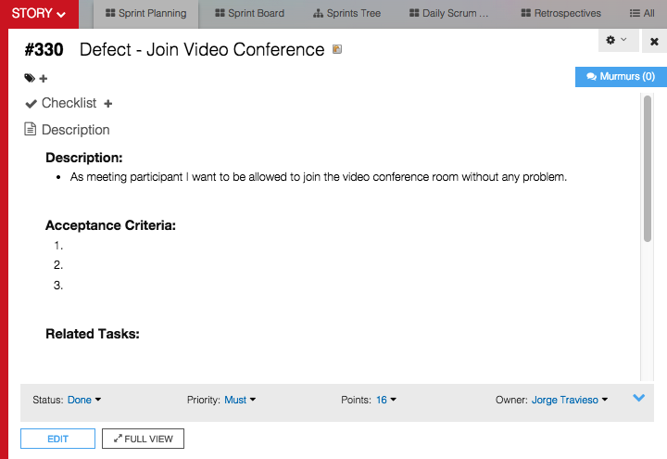

Slide 5
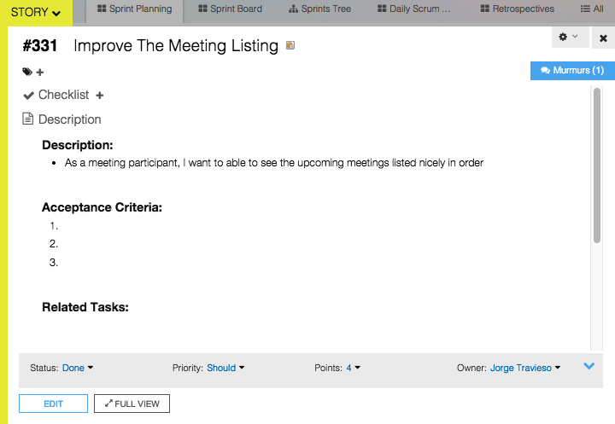

Slide 6
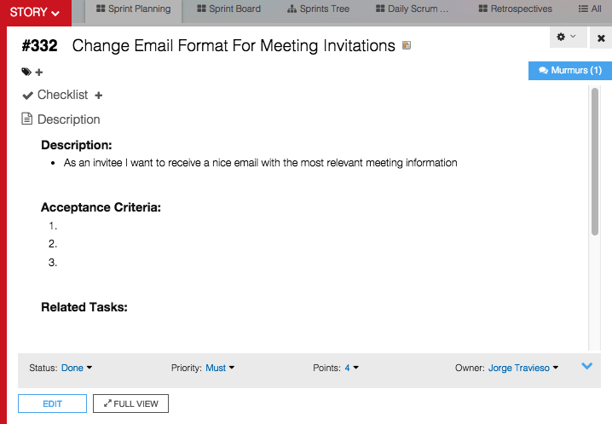

Slide 7
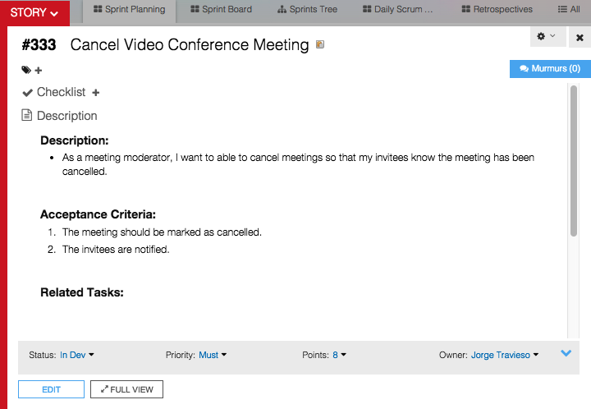

Slide 8
Sprint #5 Planning
4 User Stories
Personal Mark: 32 Points / 32 Planned
Sprint Velocity: 62 Points
Estimate based on
Documentation update time
Design and implementation

Slide 9
Self Review
User Story | Status | Accepted
Defect - Join Video Conference | Done | TBD
Improve The Meeting Listing | Done | TBD
Change Meeting Invitation Email Format | Done | TBD
Cancel Video Conference Meeting | Done | TBD

Slide 10
Daily Scrums Summary
Major Accomplishments
Updated the documentation
Use cases and sequence diagrams
Fixed
Error preventing some users to join a VC room
Email invitation format
Video conference listing
Added features
Cancel a video conference invitation

Slide 11
Documentations Updates

Slide 12
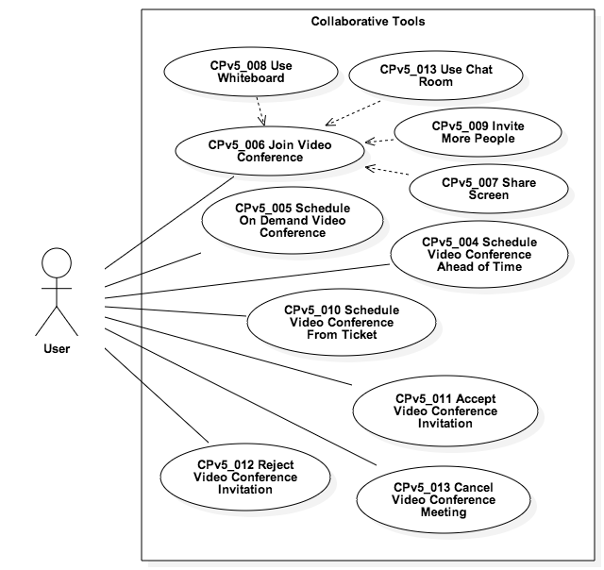
Use Case Model

Slide 13
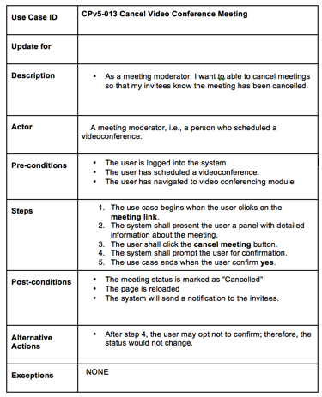

Slide 14
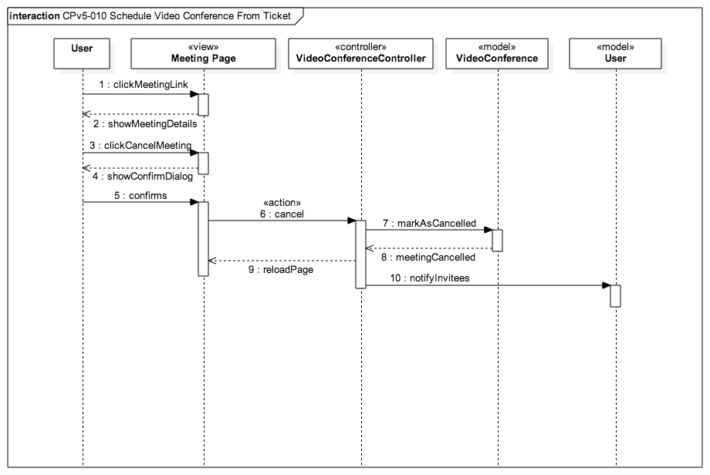

Slide 15
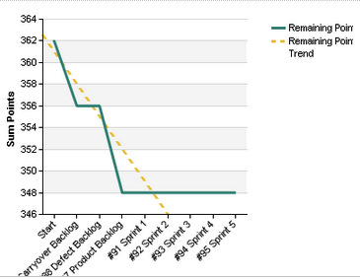
Burndown Chart

Slide 16
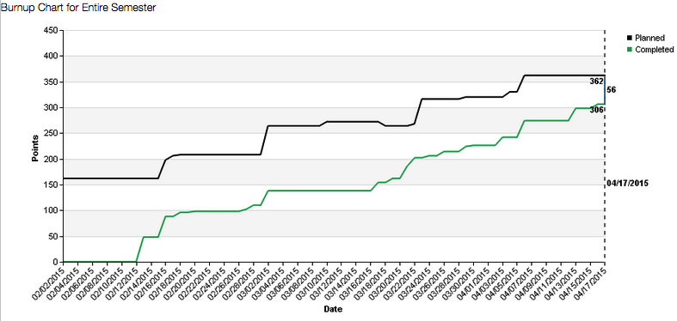
Burnup Chart

Slide 17
Demo
http://cp-dev.cis.fiu.edu/coplat/index.php/videoConference

Slide 18
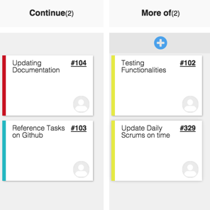
Sprint #4 Retrospective

Slide 19
